Slide 1
Entrepreneurial Finance Preparing for The Deal
Professor Burnes
Leeds School of Business
University of Colorado Boulder
Leeds
B U S I N E S S
Page 1

Slide 2
Reviewing Schedule to End
14.2 Collecting the Deal Parts
15.1 Strava
15.2 SpinMaster
15.3 Review for Final
FINAL 12/14 4:30 -7:30 pm

Slide 3
Deal Parts
5 Year Pro Forma
What are you Raising? Why?
Cap Table
Valuation
Term Sheet
Due Diligence

Slide 4
Term Sheet
A Term Sheet is non-binding, BUT it represents a serious step forward.
If an investor asks for a Term Sheet, this is a good sign, and you should be ready.
It opens negotiations AND indicates that you understand expected elements and conditions of an agreement
Please see the Foundry Term Sheet 2017
Used with Permission

Slide 5
Term Sheet Take Aways
Financing: How much raising
What are you selling: Common vs Preferred Shares; Convertible Notes
Investors: WHO is playing
Unissued Employee Pool:
Pre Money Valuation
Number of Shares, $/Share
Voting Rights
Liquidation Preferences
“no shop”

Slide 6
Due Diligence
Please see example provided in Modules. This is good early stage company example DDR
Market
Competitors
You relative to Competitors
Multiples, other Exits
Raise Why
Proposed Valuation Assessment

Slide 7
DDR Take Aways
Information comes through “Data Room” and market information
Org Chart, Team Qualifications
Product
Market (size, potential,)
Company Strategy
Competitors
Financials: growth, burn rate
Cap Table
Exit
Valuation
This is the investor’s work to evaluate their findings relative to company and set a basis for valuation/investment

Slide 8
WHAT about NDA??

Slide 9
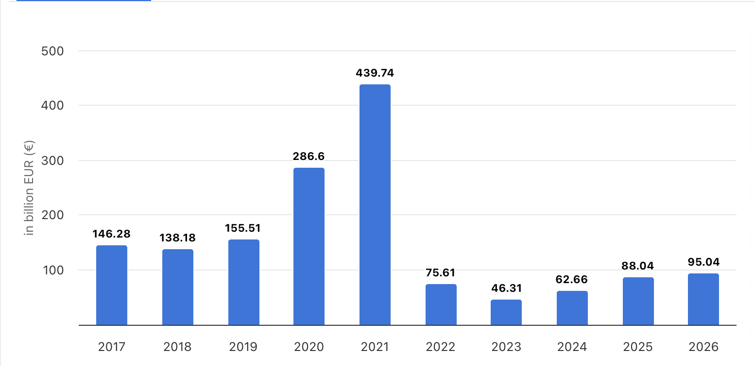
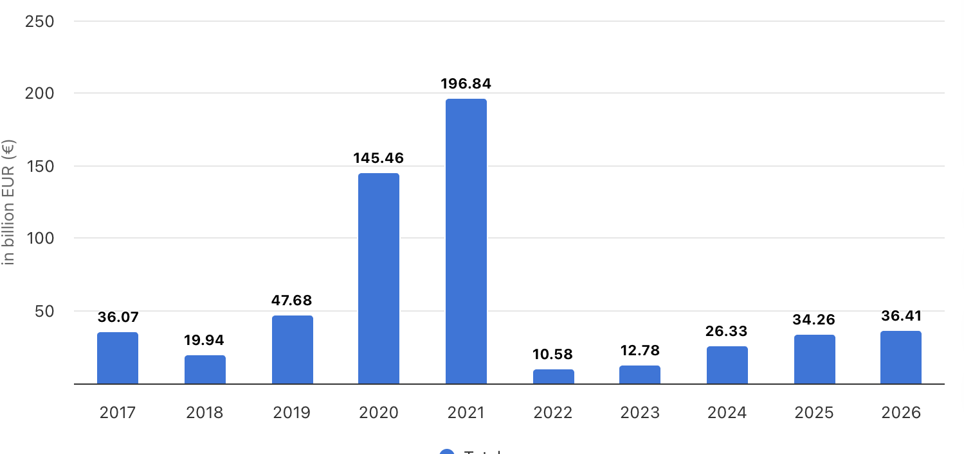
IPO TRANSACTION VOLUME
Worldwide
U.S.

Slide 10
IPO – This is an 18-24 month process*
Prep
Select Underwriter
SEC
Pre Sell
Team
Auditors
Legal
Investment Bank & Syndication
Notice S1
Ascertain Price
Roadshow
Pricing Meeting
Allocate Shares
Institutional Investors
Investment Bank & Syndication
Close Order Book
*depending on firm and market

Slide 11
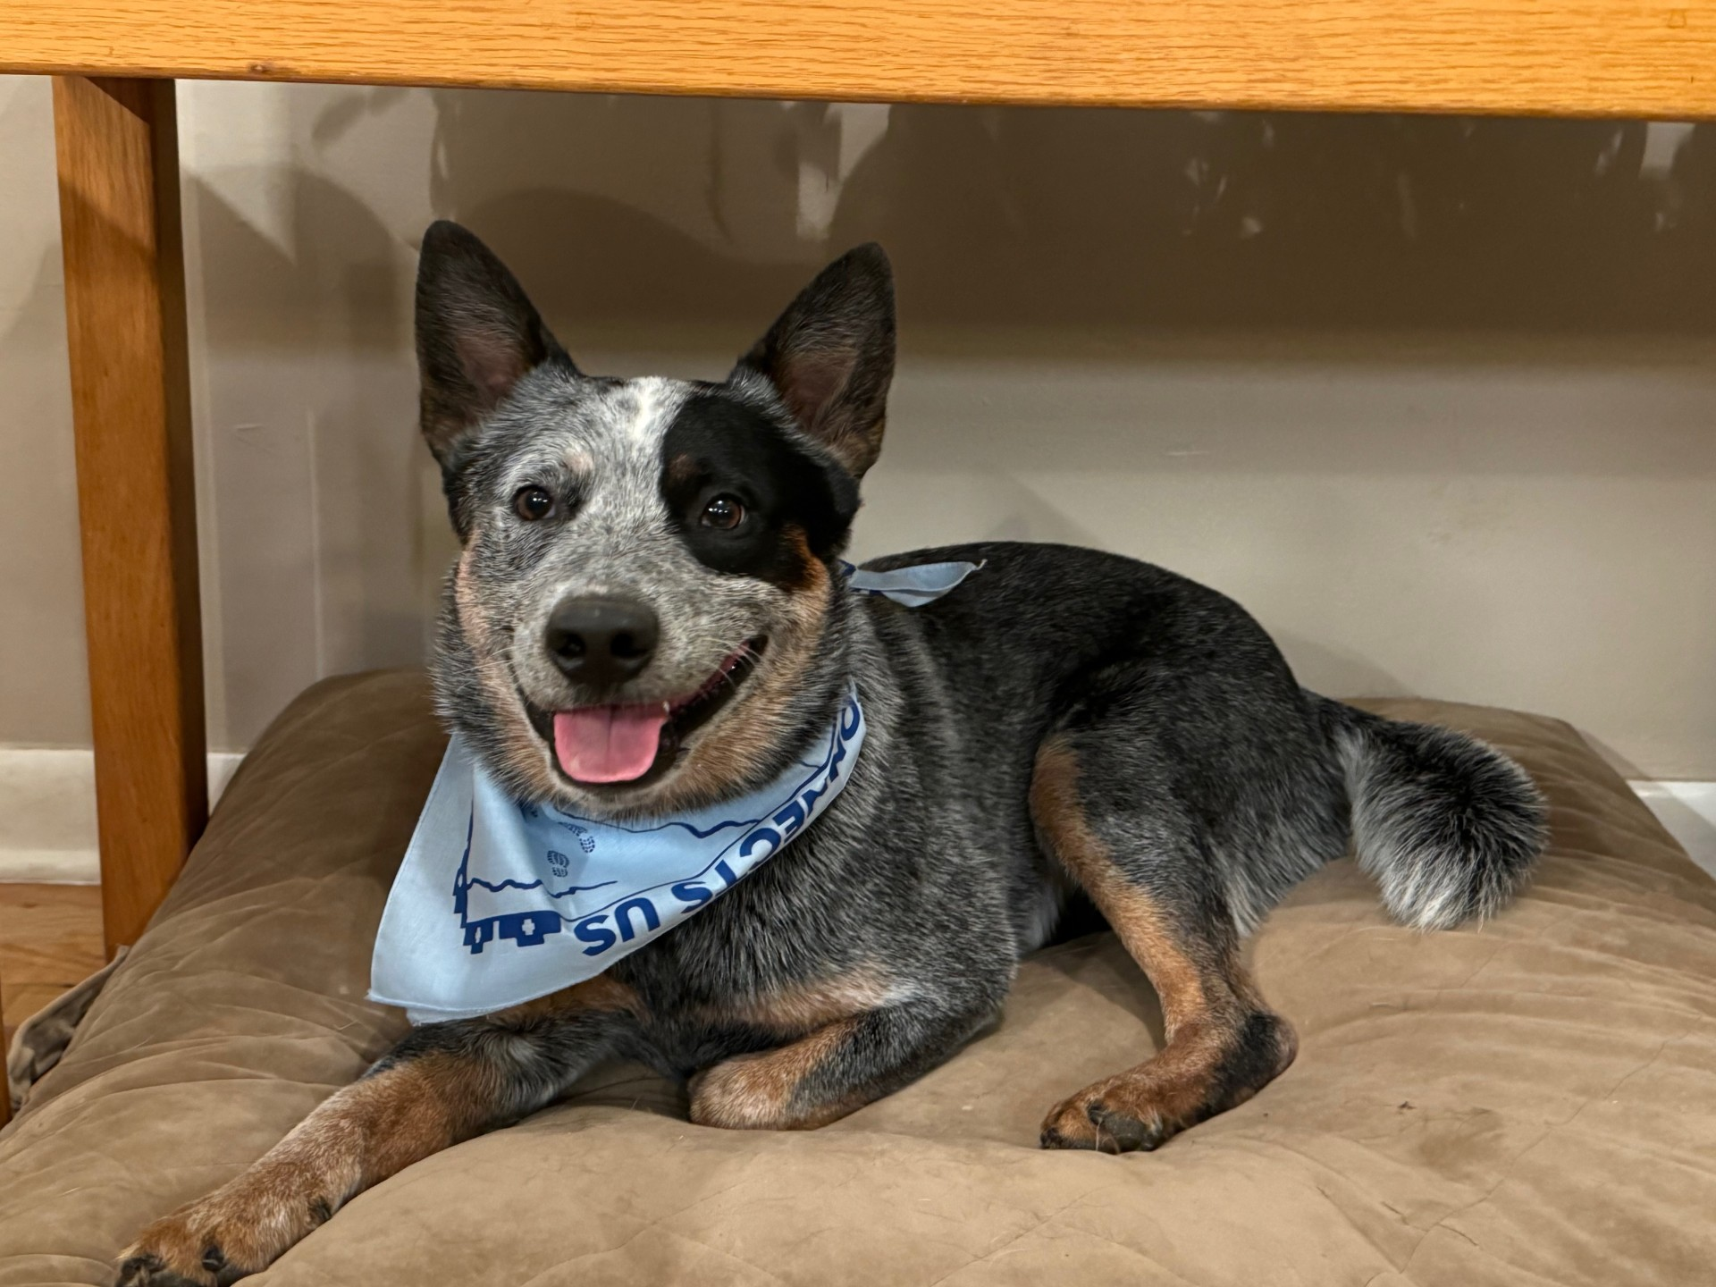
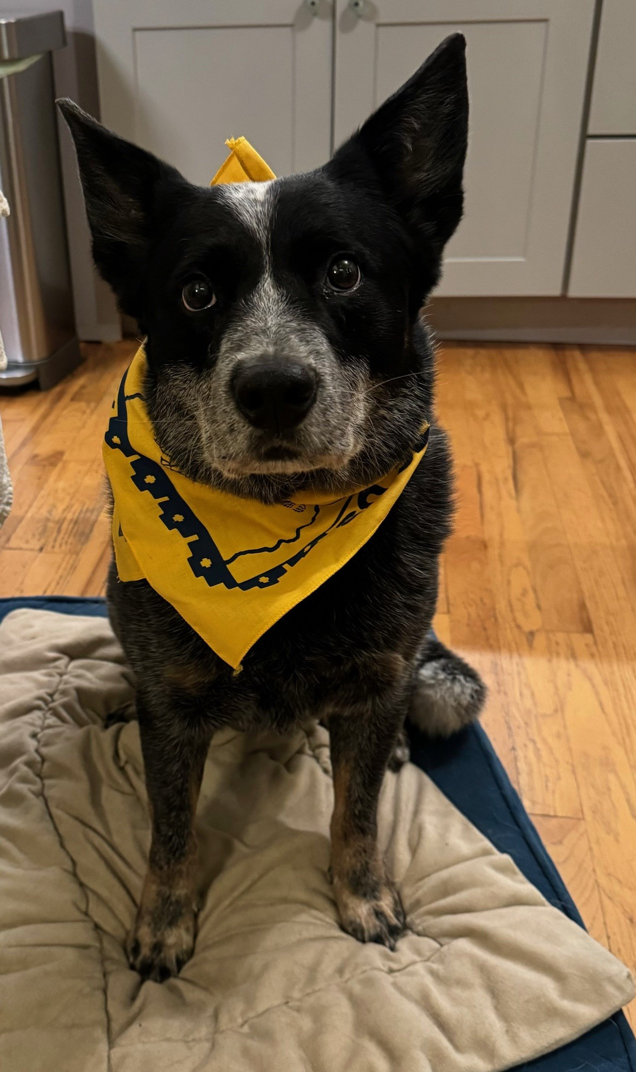
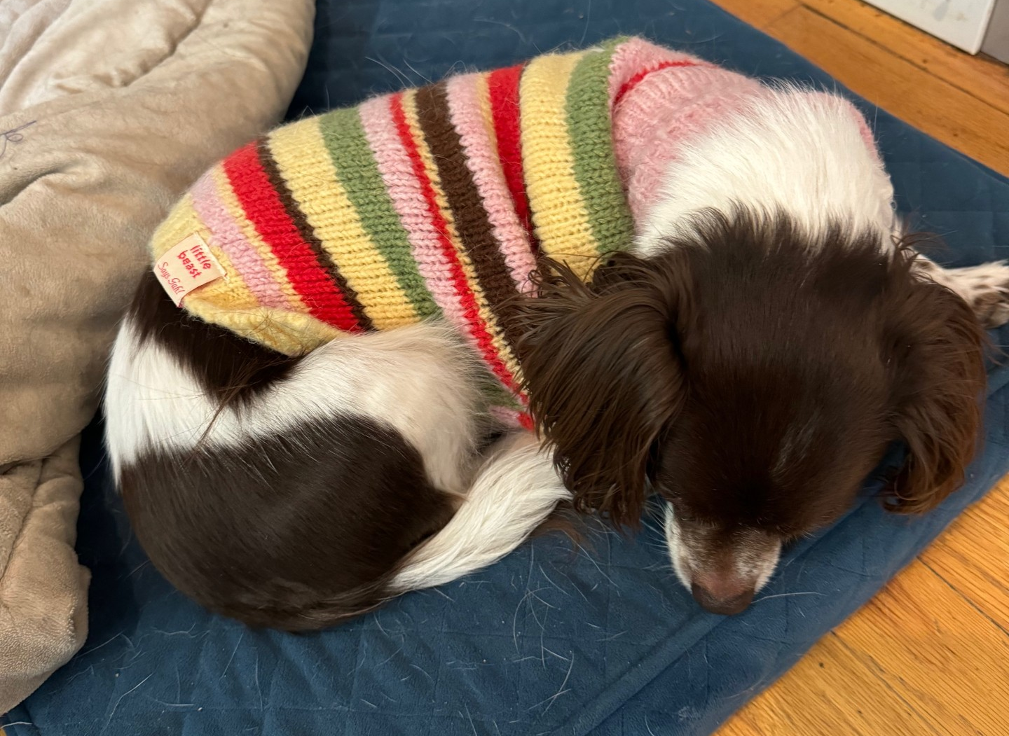
Have a SAFE and relaxing Fall Break

